Slide 1

Text Summarization: Extracting Insights from Information Overload
In an age of unprecedented digital content, the ability to quickly grasp essential information is paramount. This presentation introduces our advanced Text Summarization system, a powerful tool designed to cut through the noise and deliver clarity.

Slide 2

The Problem: Drowning in Data, Thirsting for Knowledge
The Information Deluge
Every day, we face an overwhelming volume of text—reports, articles, emails, research papers. This constant influx leads to:
Information overload and decision paralysis.
Significant time spent reading non-essential content.
Difficulty identifying critical insights quickly.

Slide 3
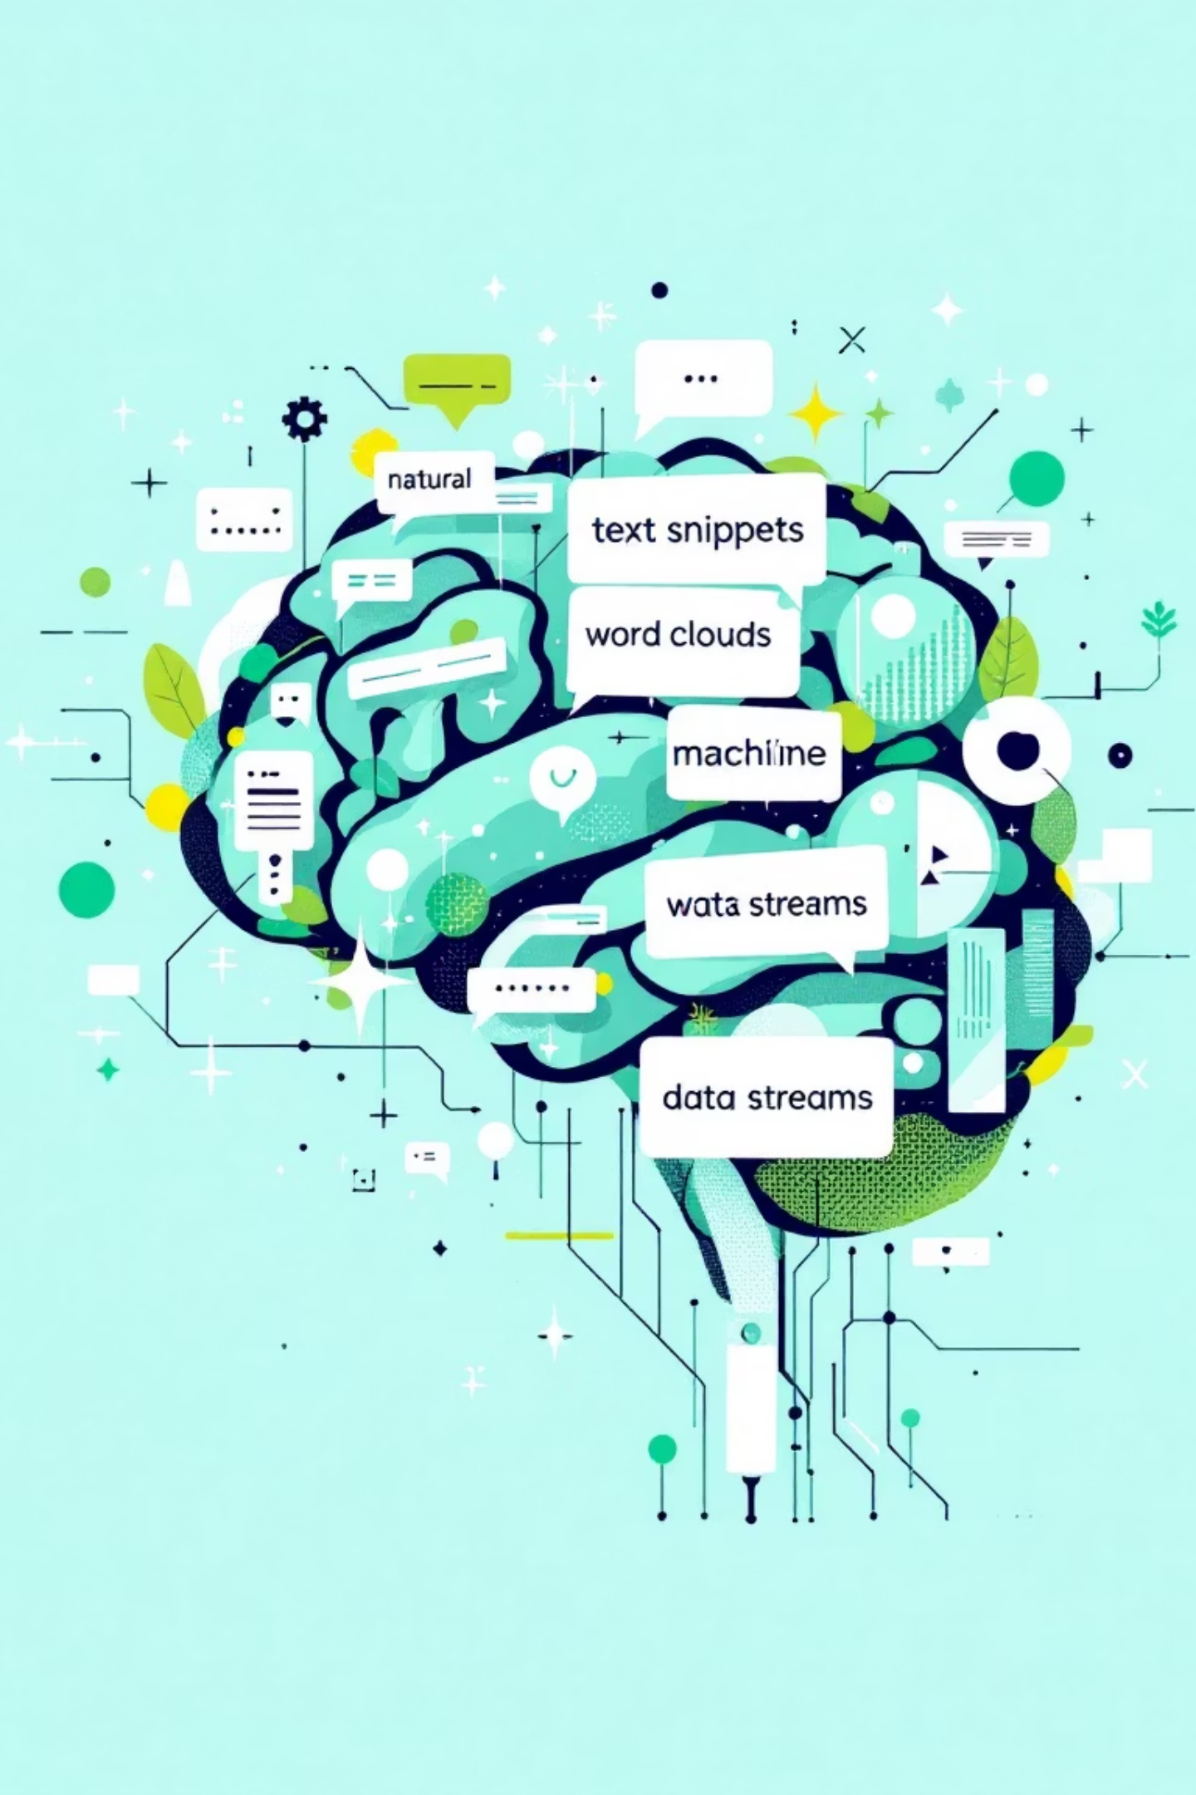

Our Solution: An NLP-Powered Text Summarization System
We've developed a sophisticated system that leverages cutting-edge Natural Language Processing (NLP) techniques to automatically generate concise and meaningful summaries. This innovative solution helps users:
Quickly understand important information.
Reduce lengthy content into brief, accurate summaries.
Enhance productivity and decision-making.
Our system focuses on both extractive and abstractive summarization, offering flexibility for various content types and user needs.

Slide 4

How It Works: Diving into the Technology and Techniques
Text Input & Preprocessing
NLP Feature Extraction
Raw text documents are fed into the system, where they undergo tokenization, sentence segmentation, and noise reduction to prepare for analysis.
Advanced NLP models identify key phrases, entities, and semantic relationships within the text, determining the most important information.
Summary Generation
Output & Refinement
Using algorithms that balance coherence and conciseness, the system constructs a summary that accurately reflects the original document's core message.
The generated summary is presented to the user, with options for further customization or length adjustment based on specific requirements.

Slide 5

Key Features & Benefits: Why Our System Stands Out
High Accuracy
Our algorithms prioritize factual correctness and contextual relevance, ensuring summaries are reliable and trustworthy.
Blazing Speed
Process large volumes of text in seconds, significantly accelerating information retrieval and analysis.
Customizable Output
Users can define summary length, style (extractive/abstractive), and focus areas, tailoring output to their needs.
Seamless Integration
Designed for easy integration with existing platforms and workflows via robust APIs and flexible deployment options.

Slide 6
Use Cases: Who Can Benefit and How
Business Professionals
Academics & Researchers
Quickly digest market research, competitor analysis, and lengthy reports to make informed decisions faster.
Summarize scientific papers, literature reviews, and educational content, saving valuable study time.
Journalists & Content Creators
Legal Professionals
Extract key facts from news feeds and source materials, enhancing content creation efficiency.
Condense legal documents, case briefs, and contracts to accelerate review processes and identify crucial clauses.

Slide 7

Future Directions: Enhancements and Expanding Horizons
Multi-Language Support: Expanding summarization capabilities to process and generate summaries in various languages.
Real-time Summarization: Developing features for instant summarization of live streams, speeches, and dynamic content.
Domain-Specific Models: Creating specialized models tailored for highly technical domains like medicine or finance to ensure even greater accuracy.
Interactive Summaries: Introducing interactive elements that allow users to drill down into summarized content for more detail.

Slide 8

Q&A and Next Steps: Your Questions, Our Vision
We invite you to explore how our Text Summarization system can transform your approach to information. We're here to answer any questions you may have and discuss how we can tailor this solution to your specific needs.
Let's Connect:
Demonstration: Schedule a personalized demo of the system.
Partnership: Discuss potential collaborations and pilot programs.
Feedback: Share your insights to help us refine our product.

